Slide 1
www.LSCarolinas.net
Notes:
Thanks
All different faiths
Don’t always have a group of community leaders in the room, so we’ll cover a lot
Q&A at the end

Slide 2
Fear of persecution for reasons of:
Race
Religion
Nationality
Membership of a particular social group
Political opinion
Who are Refugees?
Notes:
The U.N. High Commissioner for Refugees (UNHCR) defines a refugee:
well-founded fear of being persecuted for reasons of race, religion, nationality, membership of a particular social group or political opinion
Cannot receive protection from their own country
Cross an international boarder
Cannot or is unwilling to return to their country because of fear

Slide 3
Special Immigrant Visa
Afghan and Iraqi nationals
Interpreters, translators, worked for the US military, allies who supported our mission in Afghanistan and Iraq
In danger of retaliation due to affiliation with the US military
Who are SIV’s?

Slide 4
Granted for urgent humanitarian reasons
Allies evacuated from Afghanistan
Temporary status – 2 years
Limited access to public benefits
Eligible to work
What is Humanitarian Parole?
Notes:
- Humanitarian parole refers to parole granted based on an urgent humanitarian need.
- Under the Operation Allies Refuge parole program, Afghans are granted protection from deportation and are eligible to apply for work authorization, and immigration status adjustments.
- At risk groups: SIVs, Social justice activists, women activists, NGO affiliates, journalists

Slide 5
Pathway to Resettlement
Notes:
This graphic illustrates the resettlement processes refugees go through in order to be admitted to the U.S. through the Refugee program.
Step 1- Leave your home country for fear of persecution: You live in a country where you are persecuted because of your race, religion, ethnicity, social group, or political beliefs. Out of fear for your life, you flee your home and cross an international border, where you seek safety in a “country of first asylum.”
Step 2- Register with the United Nations High Commissioner for Refugees (UNHCR) for refugee status determination: UNHCR collects biometric data, biographic information, identifying documents, and conducts interviews to determine whether or not you qualify for refugee status. If UNHCR verifies your need for protection, you receive an ID card that allows you to stay in a refugee camp or urban environment.
Step 3- Resettlement Processing Interviews and Security Screenings: If you are not able to return home or settle in the country to which you fled, you may apply for resettlement in a third country, such as the U.S. If you are referred to resettlement in the U.S, you undergo extensive screenings, multiple reviews of your application, and an interview with a United States Citizenship and Immigration Services (USCIS) officer, who then is responsible for approving or denying your application for resettlement.

Slide 6
Pathway to Resettlement
Notes:
Step 4- Conditional Approval and More Security Screenings: If all the necessary criteria are met, you will be conditionally approved for refugee status. You must pass another round of security screenings, which are detailed in the Security Screening Chart. This includes passing a medical screening.
Step 5- Journey to the United States: A very small number of refugees are approved for resettlement in the U.S. If you are one of the few, you are assigned to a national Resettlement Agency, such as Lutheran Immigration and Refugee Service (LIRS) who then assigns your family’s case to one of the local resettlement agencies who will prepare for your arrival.
Step 6- Welcome to the United States: Upon arrival, you will undergo security checks one last time by a Customs and Border Protection (CBP) officer, to verify that you have the proper documentation and that you are the same person. Once through security, you are met by members of the local resettlement agency and other volunteers who will walk with you as you begin to settle into life in the U.S.

Slide 7
1. Registration with the United Nations.
2. Interview with the United Nations.
3. Refugee status granted by the United Nations.
4. Referral for resettlement in the United States.
5. Interview with State Department contractors.
6. First background check.
7. Higher-level background check for some.
8. Another background check.
9. First fingerprint screening; photo taken.
10. Second fingerprint screening.
11. Third fingerprint screening.
12. Case reviewed at United States immigration headquarters.
13. Some cases referred for additional review.
14. Extensive, in-person interview with Homeland Security officer.
15. Homeland Security approval is required.
16. Screening for contagious diseases.
17. Cultural orientation class.
18. Matched with an American resettlement agency.
19. Multi-agency security check before leaving for the United States.
20. Final security check at an American airport.
Steps Prior to Resettlement
Notes:
Average stay in a camp is 26 years

Slide 8
Rapid processing at Kabul airport
Evacuate to military bases in third countries
Security processing, medical screening
Fly to the USA into multiple military bases
Additional security screening, EAD application, Covid testing and 1st vaccine
Resettlement
Status adjustment
Humanitarian Parole for Afghans

Slide 9
Four Goals of Resettlement
Safe and stable environment
Can navigate relevant systems
Connected to ongoing support
Understands surroundings
Resettlement Goals
Notes:
Refugee resettlement in the United States is a public-private partnership. That means the federal and state agencies work closely in partnership with nonprofit organizations, volunteers, and private donors to provide support to refugees when they first arrive.
The State Department’s Bureau of Population, Refugees, and Migration (PRM), set four specific goals for each family of refugees.
The refugee is in a safe, stable environment.
The refugee can navigate appropriate and relevant systems.
The refugee family is connected to means of ongoing support for self/family.
The refugee understands their surroundings and situation.
These essential goals must be met in order for newly arrived refugees to start working towards long-term integration. The main objective is for refugees to both have access to the resources and develop the skills and confidence to navigate their lives in the United States and become self-sufficient.

Slide 10
Full Integration or “The Long Welcome”
Notes:
Understanding the typical cultural adjustment curve will help you relate to the culture shock the family may be experiencing as they integrate into the United States.
The first month or two are considered the honeymoon stage when adjustment experiences are new and exciting
Shortly after, things begin the downhill drop, with a low point or “culture shock” occurring between the 3rd and 6th month
Finally, comes the uphill climb, which commonly occurs between 6 month to 1-year post-arrival where surface adjustment is achieved
It is important to recognize the psychological and emotional support you and others can provide to the refugee family over the course of this long period of adjustment.

Slide 11
68.5 million displaced individuals
25.4 million refugees
50% are under the age of 18
1% of refugees are resettled in a third country
Worldwide Statistics
Notes:
Average stay in a camp is 26 years

Slide 12
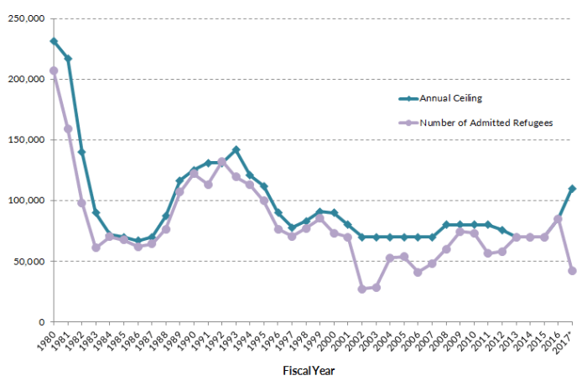
2021 Determination: 65,000
Historically US resettles 80,000 – 110,000 refugees annually
Presidential Determination
Notes:
Cap, not a goal

Slide 13
Refugees and SIVS: 175
Afghan Placement and Assistance: 100
LSC Charleston Refugee Admission Numbers
Notes:
Cap, not a goal
Columbia: 250 + 200
Greenville: 100 + 50
Raleigh: 300 + 200
Asheville: 100 APA

Slide 14
Africa, East Asia, Europe and Central Asia, Latin America/Caribbean, Near East/South Asia
*this is decided upon by the President in an Executive Order given each September.
Refugee Admissions
Notes:
DATA RE: ARRIVALS FY16,17,18

Slide 15
Circle of Welcome
Notes:
You can see why partnerships are needed

Slide 16
A New Look at Co-sponsorship
Welcoming the stranger and caring for their needs is a calling that is shared by most faith traditions and people of good conscience.
Perhaps now more than ever, there is a critical need for private support for resettling refugee families and walking with them as they rebuild their lives.
Program Overview
Notes:
CoW – most comprehensive way of engaging
New program across the country
Three models, depending on location and availability
We provide training and ongoing support

Slide 17
Newly Arrived Model
Post-Arrival Model
Distant Partner Model
Establish volunteer team
Assist with core services
Assist with essential activities
Focus on integration & friendship
Provide spiritual, emotional and financial support to refugee and resettlement agency
6 months - 1 year commitment
Circle of Welcome Models

Slide 18
Organize your Group
Outreach and Recruitment
Financial Assistance
Prepare for the family’s arrival
Furnishings and Supplies
Welcome Home
Stock the Pantry
Welcome Meal
Airport Pick-up
Support Integration
Core Services
Seasonal Clothing
Community Guide
Transportation Assistance
Health
English Conversation
Financial Education/Literacy
Job Development
Friendship
Communicate Regularly
(all parties)
Reporting Issues/Concerns
Setting goals and quarterly expectations with family
Measuring Impact
Build Support for Refugees
Spiritual Considerations
Advocate
Recruit Volunteers
Circle of Welcome Activities
Notes:
There are a variety of activities for your team to engage in. While the ultimate responsibility to fulfill these services belongs to the us, the local resettlement agency, the expectation is that your team is prepared to undertake all of the activities listed for a one year period.
The final distribution of activities will be determined in collaboration with the local resettlement agency.

Slide 19
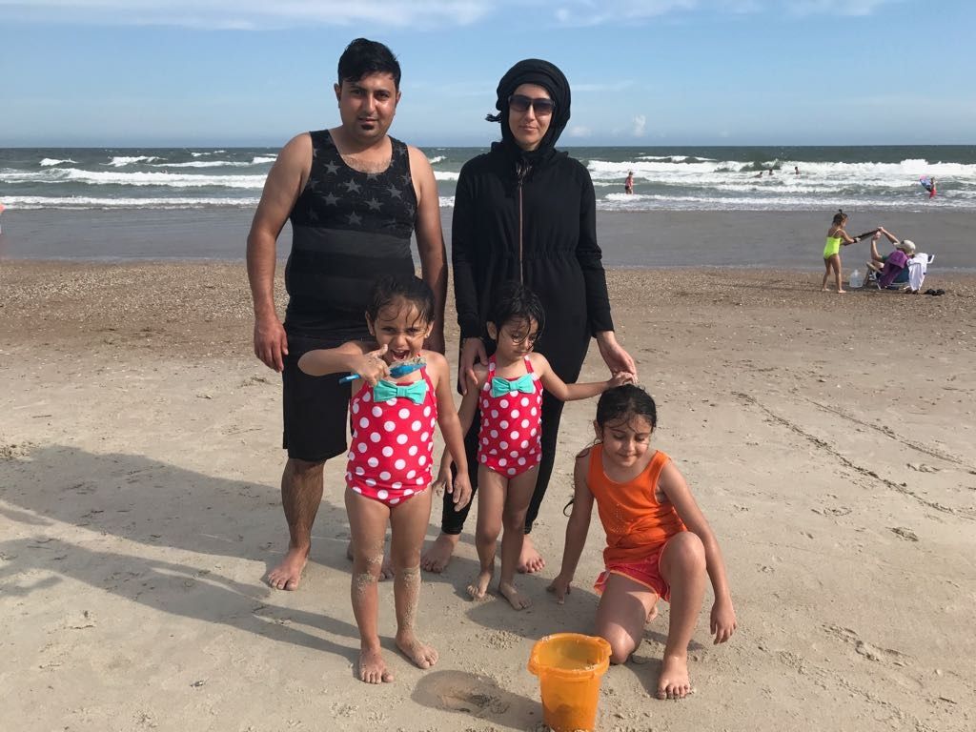
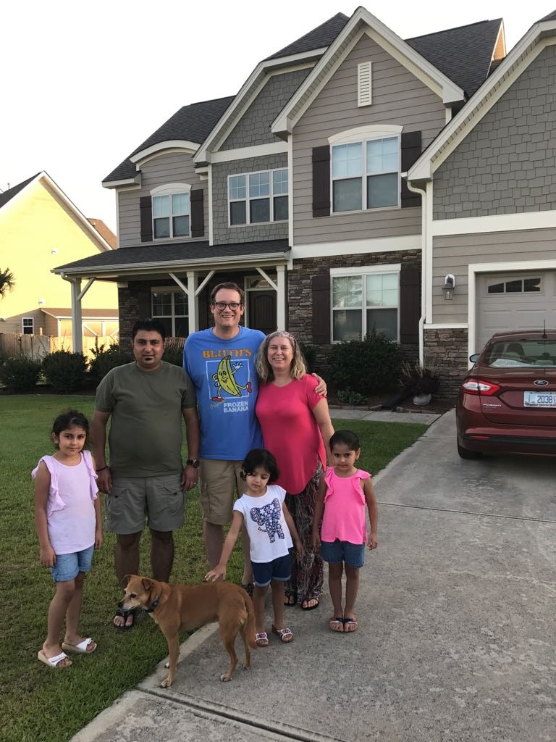
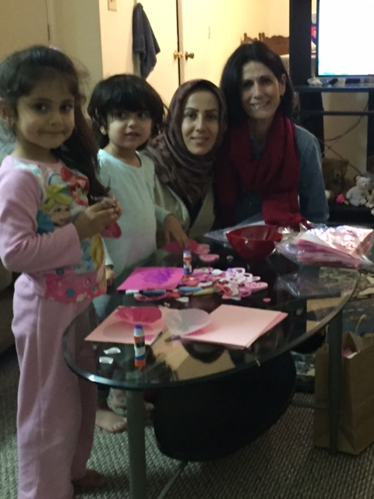
Integration leads to belonging
Notes:
Average stay in a camp is 26 years

Slide 20
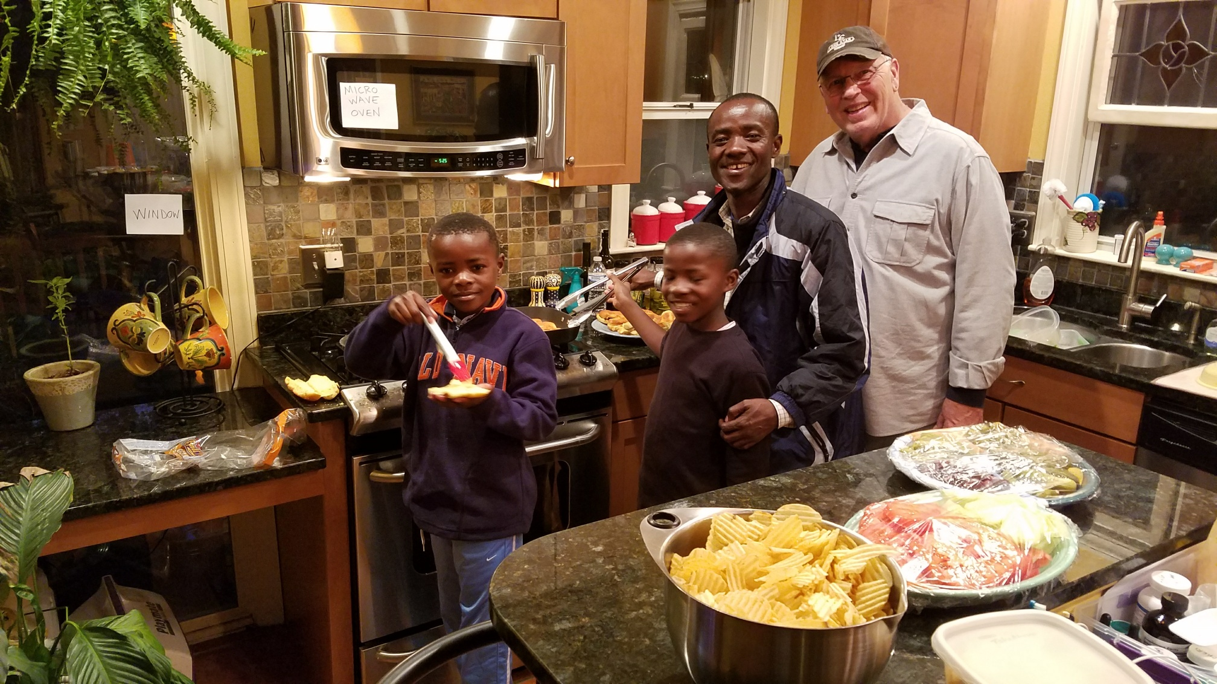
Integration leads to belonging
Notes:
Average stay in a camp is 26 years

Slide 21
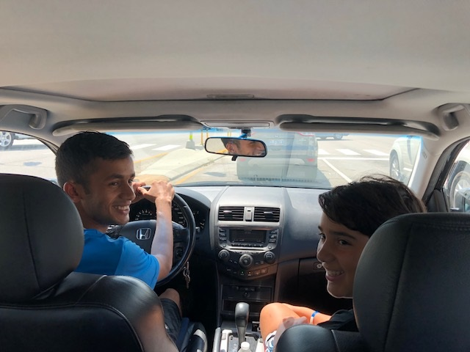
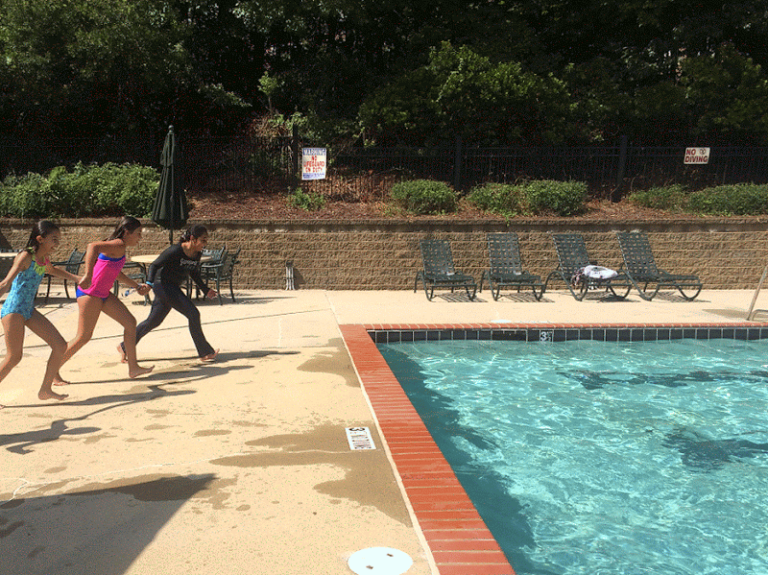
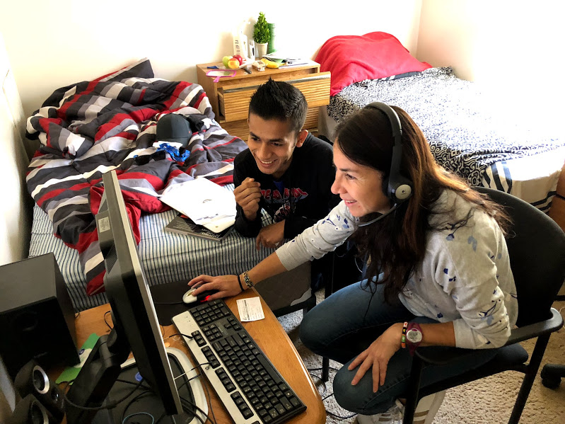
Integration leads to belonging
Notes:
Average stay in a camp is 26 years

Slide 22
“If we have no peace, it is because we have forgotten that we belong to each other.”
-Mother Teresa
Contact: Bedrija Jazic – bjazic@lscarolinas.net
Notes:
Average stay in a camp is 26 years

